Slide 1
Chapter 10 Cooperatives and Family Businesses
Contemporary issues in Social Accounting

Slide 2
Chapter Structure
The Cooperative Movement
Family Business
Organisational Model and Governance Structures
Who governs, board roles and relationships
Public’s trust

Slide 4
The Cooperative Movement: Evolution and aim
Fenwick Weavers Society and Rochdale Pioneers
The ICA defines a cooperative as “an autonomous association of persons united voluntarily to meet their common economic, social, and cultural needs and aspirations through a jointly-owned and democratically-controlled enterprise” (ICA, 2015).
Dual Purpose: (economic and social)
Corporate governance
Main aim to increase members’ professional and household value

Slide 5
The Cooperative Movement: Evolution and aim (continued) Cooperative principles:
Voluntary and open membership
Democratic member control
Member economic participation
Autonomy and independence
Provision of education, training and information
Cooperation among cooperatives
Concern for the community

Slide 6
The Cooperative Movement: Theoretical perspectives
single objective?
Cooperatives
multiple objectives?
According to Shaw (2006,)good corporate governance results into:
better access to external finance,
low cost of capital,
better firm performance

Slide 7
Group Activity
Group Task
Cooperatives are often seen as organisations of many individuals with each attempting to pursue their own goals (Sexton, 1984; Shaffer, 1987). Discuss what these goals might be.

Slide 8
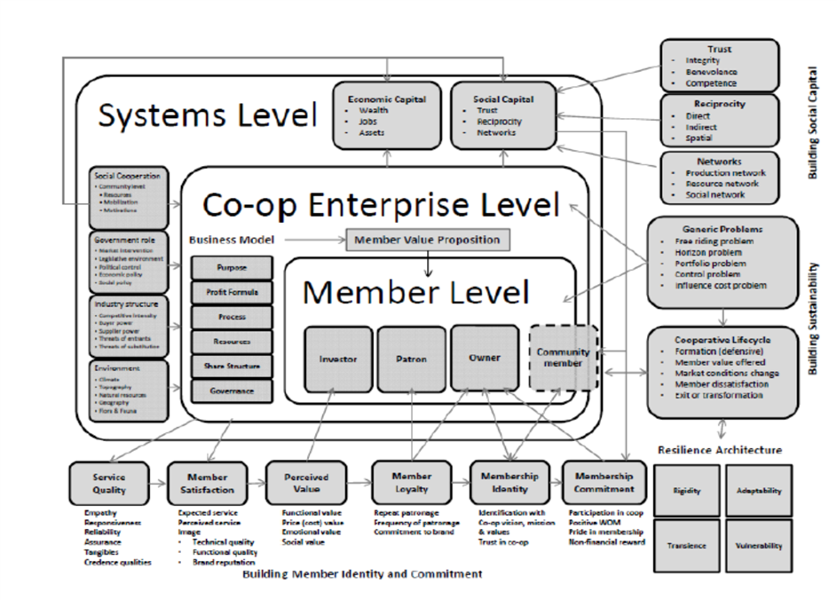
The Cooperative Movement: Theoretical perspectives (continued)
Figure 1: Conceptual framework of cooperative enterprise research (Mazzarol et al., 2011, p. 7)

Slide 9
Cooperatives and social capital
Educational aim:
Roots in the Rochdale Pioneers
Lack of knowledge => growth obstacles
Operating related issues and culture
Common enterprise system:
Avoid exploitation
Avoid marginalization of weaker social groups
Fight inequality

Slide 10
Cooperatives and social capital (continued)
Boost of economic democracy
Solidarity
Social skills
Low prices

Slide 11
Cooperatives and performance
As Kyazze et al. (2017) identify, cooperatives’ performance is affected by:
Monitoring rights
Ratification of management decision
Innovation and policy compliance
Offering social benefits improves cooperatives’ performance (Karthikeyan, 2013).
Good corporate governance practice, improves cooperatives’ performance (Ruben & Heras, 2012).

Slide 13
Family Business
The Institute of Family Business (IFB) states a firm is considered a family enterprise, if:
1. The majority of votes are owned by the person or persons who established the firm, or those who have acquired the share capital of the firm or who are in the possession of their spouses, parents, child or child's direct heirs.
2. The majority of votes may be indirect or direct.
3. At least one representative of the family or kin is involved in the management or administration of the firm.
4. Listed companies meet the definition of a family enterprise if the person, who established or acquired the firm (share capital) or their families or descendants possess 25% of the right to vote as mandated by their share capital.

Slide 14
Family Business- examples
Swire group
Laine O’Rourke
Associated British Foods
Arnold Clark

Slide 15
Group Activity
Group Task
It has been argued that family ownership could either be perceived as an opportunity or a threat. Discuss possible reasons for these perceptions.

Slide 16
Family Business and social capital
‘the family is a source, builder and user of social capital’ (Bubolz, 2001, p. 130)
Moral behaviour
Coordination and cooperation
Stability and interaction
Socialisation
Solidarity

Slide 17
Cooperative business model- main spheres
Board and executive team
Organisational structure
community
membership

Slide 18
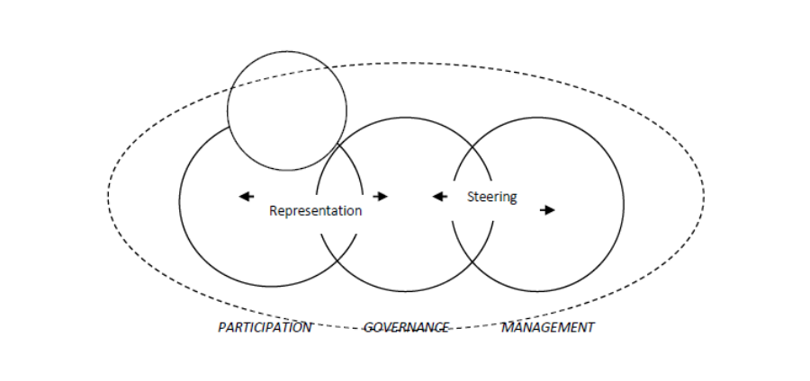
Organisational model and governance structures (continued)
Figure 2: Overlaps between participation, governance and executive management (Mazzarol et al., 2011, p. 16)

Slide 19
Accountability and governance models
Compliance
Partnership
Democratic
Stakeholder
Co-optation
‘Rubber stamp’

Slide 20
Organisational management theories
Agency theory
Stewardship theory
Resource Dependency theory
Stakeholder theory
Managerial hegemony theory

Slide 21
Cooperatives and family business: organizational model
Dedicated and enlightened membership votes
Corporate governance principles
Strategy in place
Serves the best interests of the membership:
passive membership => failure to monitor needs
active membership => might prevent the efficient running of the business

Slide 22
Who Governs
Boards have a difficult balancing act to perform:
Board members should be selected mainly for their desire to serve membership (democratic perspective and stakeholder theory).
Board members should be selected for their expertise, experience and ability to add value to the enterprise (stewardship theory).
e.g. balancing directorial experience and organisational memory against recruiting new member talent that may have the ability to see the enterprise from a different perspective and present ideas that are novel, innovative and performance enhancing

Slide 23
Group Activity
Group Task
Discuss the advantages and disadvantages of selecting the board members based on: i) democratic and stakeholder theory, and ii) stewardship theory.

Slide 24
Board roles
must act in ‘conformance’ to the interest of owners/members
work to add strategic decision-making ‘performance’ value
determine how much time to allocate to each of these potentially conflicting roles
‘conformance’ versus ‘performance’

Slide 25
Board roles- paradoxes
when taken individually, board roles are “rather one dimensional, only illuminating a particular aspect of the board’s role”, leading to a demand for integration of the insights of these different theories in an effort to develop a new framework (Hung, 1998; Tricker, 2000)

Slide 26
THEORY | INTERESTS | BOARD MEMBERS | BOARD ROLE
Agency theory | ‘Owners/members’ and managers have different interests | ‘Owners/members’ representatives | Conformance: - safeguard owners’ interests - oversee management - check compliance
Stewardship theory | ‘Owners/members’ and managers share interests | ‘Experts’ | Improve performance: - add value to top decisions/strategy - partner/support management
Resource dependency theory | Stakeholders and organisation have different interests | Chosen for influence with key stakeholders | Boundary spanning: - secure resources - stakeholder relations - external perspective
Stakeholder theory | Stakeholders have different interests | Stakeholder representatives | Political: - balancing stakeholder needs - make policy - control management
Managerial hegemony theory | ‘Owners/members’ and managers have different interests | Owners/members’ representatives | Symbolic: - ratify decisions - give legitimacy (managers have real power)
Democratic perspective | Members/the public have different interests | ‘Lay/member’ representatives | Political: - represent member interests - make policy - control executive
Table 1: A comparison of theoretical perspectives on organizational governance

Slide 27
Board relationships with management
when either control or collaboration is overly stressed, there is a risk of a separation of responsibilities or ‘groupthink’, respectively (Sundaramurthy & Lewis, 2003).
the relationship between a board and its executive management constantly shifts between consensus, difference and disagreement, depending on prevailing situations and circumstances (Kramer, 1985).
Different expectations between board members and senior management => tension and conflict.
Solution
Who should be doing what and why

Slide 28
Public’s trust
Family business scandals:
Gucci
Dassler brothers
Cooperatives scandals:
Umbrella Co-op
24 Deposit-Taking Co-ops
Malay Officers Cooperative Credit and Investment

Slide 29
Boosting public’s trust
CECOP-CICOPA:
‘introduce modern farming methods and new productive activities to restore dignity and value to people through the creation of a social economy, to promote respect for the environment and to develop people’s awareness and consumption of local products’ (CECOP, 2017).

Slide 30
Chapter summary
Characteristics of cooperatives
Characteristics of family business
Main purpose of existence
Theoretical perspectives and social capital
‘who governs’, ‘board roles’ and ‘relationships with management’
Governance and social accountability
Impact on society and community

Slide 31
Further Reading
Bubolz, M., 2001. Family as source, user, and builder of social capital. Journal of Socio-Economics, 30, pp. 129–131.
CECOP, 2017. Social farming in Italy: hoe the social cooperative, Un fiore per la vita, is showing the way forward, available at: http://www.cecop.coop/Social-farming-in-Italy-how-the-social-cooperative-Un-fiore-per-la-vita-is
Hung, H., 1998. A typology or theories of the roles of governing boards, Corporate Governance, 6(2), pp. 101-111.
ICA, 2015. Cooperative definition Available at: <http://ica.coop/en/whats-co-op/co- operative-identity-values-principles.
Karthikeyan, M., 2013. Social Statement Approach to Cooperative Social Performance Assessment: A Case of Lume Adama Farmers Cooperative Union in Ethiopia. 4th EMES International Research Conference on Social Enterprise – Liege.
Kramer, R.M., 1985. Toward a contingency model of board-executive relations. Administration in Social Work, 9(3), pp. 15-33.
Kyazze, L.M., Nkote, I.N. & Wakaisuka-Isingoma, L., 2017. Cooperative governance and social performance of cooperative societies. Cogent Business Management, 4, pp. 1-14.

Slide 32
Further reading
Ruben, R. & Heras, J., 2012. Social capital, governance and performance of Ethiopian coffee cooperatives. Annals of Public and corporate economics, 83(4), pp. 463-484.
Sexton, R. J., 1984. The Formation of Cooperatives: An Analysis of Entry Incentives, Entry Deterrence, Optimal Financing Arrangements, and Stability Requirements. Ph.D. dissertation, University of Minnesota.
Shaffer, J. D., 1987. Thinking About Farmers' Cooperatives, Contracts, and Economic Coordination. In Cooperative Theory: New Approaches, ed. Jeffrey S. Royer, pp. 61-86. Washington D.C.: USDA ACS Service Rep.
Shaw, L., 2006. Overview of Corporate Governance Issues for Co-operatives. Manchester, UK. The Co-operative College.
Sundaramurthy, C. & Lewis, M., 2003. Control and Collaboration: Paradoxes of Governance, Academy of Management Review, 28(3), pp. 397-415.
Tricker, B., 2000. Editorial - Corporate Governance - the Subject Whose Time has Come, Corporate Governance, 8(4), pp. 289-296.

